Slide 1
Opening our doors
The Christian Church in Illinois & Wisconsin

Slide 2
Agenda
What we know for sure…
Covenant Relationship
Phases for re-opening based on public health teaching
Questions to Consider | Checklist
What’s next
Communication and Technology Considerations
Regional Staff Resources
Questions

Slide 3
What we know for sure…
God is at work, always
Caring for others must be our first concern
We are connected
What happens to the least of these, happens to Jesus and his people
New Commandment---Love
This can be a new beginning
It will be a long process
Be flexible
We can be creative and innovative
We can embrace the change, learn from the experience, and imagine a new world and worship experience

Slide 4
Covenant Relationship
Congregational leaders have the final decision regarding their places of worship
These are recommendations based on the Wisconsin Council of Churches, Insurance Board, Illinois Department of Health, CDC and other sources as documented

Slide 5
Phases for Returning to Church

Slide 6
Phase I: Criteria
Look for two weeks of declining case counts
Widespread availability of testing
Contact tracing
No Personal Protective Equipment (PPE) Shortages
Source: Wisconsin Council of Churches

Slide 7
Phase I
Worship
Church Business
Continue holding online worship services only
Consider resuming recording in the sanctuary while maintaining 6 ft of space
High risk individuals should continue to shelter in place
Limit office functions. Those in office should be wearing masks and surfaces should be sanitized

Slide 8
Phase I
General Building
Small Groups
Consider allowing building users/renters back in (music lessons) as long as they abide by gathering limits, distancing protocols and you can accommodate cleaning needs.
Bible Studies and Small Groups continue to meet online.
Church councils and leadership teams of less than 10 who consider meeting should wear masks, maintain social distancing or continue meeting online.

Slide 9
Phase II: Criteria
Look for several weeks of declining case counts
Widespread availability of testing
Contact tracing
No Personal Protective Equipment (PPE) Shortages
Continued observations of physical / social distancing
Source: Wisconsin Council of Churches

Slide 10
Phase II
Recommendations:
Churches over 50 average worship attendance should consider continuing online worship.
Multiple services may be an option. You will need to ensure sanitation practices between services
Churches under 50 consider holding in person but ensure social distancing guidelines can be followed
Back-up plan in case of overflow
If you have an online presence, continue it for people who are high-risk and can not join in person
Source: Wisconsin Council of Churches

Slide 11
Phase II
Worship Recommendations
Everyone should wear cloth face masks
High risk individuals should consider continuing to shelter in place
Consider ordering individual communion sets
It is recommended against singing in the sanctuary, when the congregation is gathered, as the spreading of droplets/aerosols would be at risk
Use screens and bulletins as alternatives to having books and bibles in the pews
Individuals should be spread out in the service with one family unit per pew with empty pews in between
If space is limited, meet in the fellowship hall or outdoors
Encourage online giving. No passing of the offering plate and no touch alterations for passing of the peace
Encourage people to leave the building rather than mingle. No offering of fellowship/coffee hour
Life rituals could take place (weddings, funerals etc.) with under 50 people present and physical social distancing
Source: Wisconsin Council of Churches

Slide 12
Phase II
Church Business
Office functions could resume while maintaining social distancing and wearing face masks
Ensure a regular cleaning routine, especially on high-touch surfaces. Also, cleaning of hands after dealing with offering etc.
Church Councils and leadership teams, of less than 10 can consider meeting in person with masks and social distancing. Remaining online is also an option.
Smaller congregations (under 50 members) can consider holding in person membership meetings if official business is required
Allow building users/renters to resume operations. They should ensure to address cleaning needs and maintain social distancing protocols
Source: Wisconsin Council of Churches

Slide 13
Phase II
Small Groups:
General Building:
Bible studies and small groups can meet in person or online
Consider keeping online options as some people will not be comfortable in person
Recommendation is not to have Vacation Bible School in person. Consider offering it online or having a no-touch drop off activity
Mission trips are anticipated to be unwise for some time. Consider it an ideal time for mission in the local area
Post signs indicating symptoms and urge people to stay home, seek medical attention, if they show any signs
Have a good stock of soap, hand sanitizer, tissue and disposable paper towels on hand. This will also include masks if you plan to provide them to your members
Weather permitting, propping doors open prevent the need for congregants to touch doors
Clean the building regularly between groups and focus on high-touch surfaces. Consider having no touch trash cans
If you become aware of someone in the church building with COVID-19, put your communication plan in action and contact tracers
Source: Wisconsin Council of Churches

Slide 14
Phase III: Criteria
Look for several more weeks of declining case counts
If numbers of infections increase, physical distancing recommendations would need to be tightened temporarily to get back on track
Widespread availability of testing
Contact tracing
No Personal Protective Equipment (PPE) Shortages
Continued observations of physical / social distancing
Source: Wisconsin Council of Churches

Slide 15
Phase III
Recommendations:
High risk individuals (people over 60 and with underlying conditions) should continue to shelter in place
Hospitals and care facilities are recommended to continuing limiting visitors which could have implications on Pastoral Care and Business.
Wear cloth face masks while at church and in community ministry in public places
Source: Wisconsin Council of Churches

Slide 16
Phase III
Worship
Church Business
Churches of all sizes offer in-person and online options
Physical distancing is not required by Phase III. However, the recommendation is to avoid overcrowding in the sanctuary as much as possible.
Consider multiple services if necessary. If so, utilize bulletins and screens as alternatives for pew bibles etc.
Watch public health recommendations on Communion and group singing
Continue to use no-touch alternatives for passing the peace, collecting offering and liturgical resources.
Continue encouraging people against mingling after service. The recommendation is against offering a fellowship/coffee hour.
Office functions could resume as normal, with attention to cleaning.
Groups, teams and committees could meet in person
Source: Wisconsin Council of Churches

Slide 17
Phase III
Small Groups
General Building:
It should be safer for Bible studies and small groups to meet in person
Maintain online options for those who are at high-risk
Post signs indicating symptoms and urge people to stay home, seek medical attention, if they show any signs
Have a good stock of soap, hand sanitizer, tissue and disposable paper towels on hand. This will also include masks if you plan to provide them to your members
Clean the building regularly between groups and focus on high-touch surfaces. Consider having no touch trash cans
If you become aware of someone in the church building with COVID-19, put your communication plan in action and contact tracers
Source: Wisconsin Council of Churches

Slide 18
PLEASE REMEMBER
Remain watchful for any new information or updates that may be shared from the CDC or the IL Department of Health etc. as we move forward.

Slide 19
Questions

Slide 20
Questions to consider Checklists

Slide 21
Questions for Church Leadership Building
Has your insurance company weighed in on benchmarks for reopening?
How many people can your worship space hold while abiding by the 6 ft apart requirement?
How will you ensure sanitation and disinfection regarding communal spaces?
What are you doing now to sanitize your church and what is your plan to clean in real-time?
Sources: Wisconsin Council of Churches, Ken Braddy

Slide 22
Questions for Church Leadership Worship
What adjustments need to be made if you will be online streaming while in service?
How will you discourage the receiving line after church and congregating of members?
In the earlier phases of the relaunch, how will you cap attendance at events considering members of the community who may decide to visit?
What adjustments will you make to the Lord’s Supper, offering, music, baptism etc.?
For churches where fellowship is important, how will you fill that void?
Are there other traditions unique to the culture of your congregation that need to be changed?
Sources: Wisconsin Council of Churches, saranaefisher.com, Ken Braddy

Slide 23
Questions for Church Leadership Communication
If someone contracts COVID-19, what is your communication plan with your congregation (while maintaining privacy & Pastoral Care)? How will you keep a record of all in attendance for follow-up communications?
How do you plan to communicate the new guidelines to members and visitors prior to their arrival at worship?
If someone who contracts COVID-19 has been in your building, how will you do more intensive cleaning prior to use of the building again?
How will you communicate your safety plan and best practices to the congregation?
What is your communication plan for visitors?
Sources: Wisconsin Council of Churches, saranaefisher.com

Slide 24
Questions for Church Leadership Church Business
What is your plan if volunteers step down?
Will your church require a new leadership position to oversee technical aspects?
If you are providing PPE, where will you purchase it and will it be readily available?
What financial adjustments need to be made if there is an impact to giving?
How will you update your building use agreements given the new realities of COVID-19?
Will employees be required to perform temperature checks at home on all attendee?
Sources: Wisconsin Council of Churches, saranaefisher.com, Ken Braddy

Slide 25
Preparing to Reopen Checklist
Identify a COVID-19 coordinator to be responsible for COVID issues at your church once your state says it is safe to reopen.
Develop policies for employee/volunteer protection and provide training to all cleaning staff. Wear disposable gloves and gowns for all tasks in the cleaning process including handling trash.
Ensure employees/volunteers are trained on the hazards of the cleaning chemicals used in accordance with OSHA’s Hazard Communication standard (29 CFR 1910.1200external icon).
All employees/volunteers should bring their own cloth face mask to the church office.
Identify critical job functions; cross-train staff and volunteers to help ensure that essential jobs will be covered.
Establish flexible hours/schedules for essential jobs to limit the number of people in the church workspace at one time.
Visit the CDC website to print and post all alerts related to COVID-19 and church operations for employees and volunteers. (Stop the Spread, Promote everyday protective measures, Properly wearing a face mask)
Prior to return of operations make sure all workspace has been thoroughly cleaned and disinfected. Follow CDC guidelines. Use products that are EPA approved for use against COVID-19.
Include cleaning and disinfecting of frequently touched surfaces: tables, doorknobs, light switches, countertops, handles, phones, keyboards, toilets, faucets, sinks, etc.
Communicate with all staff and volunteers in advance regarding return to work requirements.
Ensure that ventilation systems operate properly and increase circulation of outdoor air as much as possible by opening windows and doors. Do not open windows and doors if they post a safety risk to children using the facility.
Ensure that all water systems and features are safe to use after a prolonged facility shutdown to minimize the risk of Legionnaires’ disease and other diseases associated with water.
Source: Insurance Board and CDC

Slide 26
Preparing to Reopen Reminders
Employees/volunteers (or their household members) returning to the church office must be COVID-19 symptom free for a minimum of 7 days.
If an employee/volunteer’s job function does not require their physical presence in the church office, allow them to work from home.
No employee should be required to return to work without adequate transition time to secure care for loved ones for whom they have responsibilities (children or older adults).
Many employees may opt to use the emergency family and medical leave provided by the Families First Coronavirus Response Act.
Ensure that sick leave policies are flexible and consistent with public health guidance, and that employees are aware of and understand these policies.
Source: Insurance Board

Slide 27
Daily Operations
Each employee/volunteer should take their temperature daily prior to coming to the church office. Monitor the readings.
If temperature is less than 100.4 degrees Fahrenheit, employee/ volunteer may go to the church office.
An employee/volunteer who experiences fever and/or symptoms while at home should not report to work.
An employee/volunteer who has a fever at or above 100.4 degrees Fahrenheit or is experiencing symptoms should immediately go home and monitor his or her symptoms. If an emergency should occur while an employee or guest is at the church office, follow American Heart Association guidelines.
A protective mask covering the mouth and nose should be worn.
Provide hand sanitizer, tissues and no-touch disposal receptacles near hand washing locations.
Encourage frequent hand washing with soap and water, and hand sanitizing when tasks are completed.
Organize the church space so employees/volunteers can practice social distancing and maintaining distance (6 feet) from others.
Source: Insurance Board

Slide 28
Daily Operations
Increase physical space between employees/volunteers and guests (spaced entry to the business, drive through, partitions).
When ready to exit the building, sanitize hands, and do not touch the door with hands. Use elbows if possible.
All other previously established infection control practices are to be maintained during work, lunch and break periods.
Any necessary meetings should have capacity limits of 10 people per the CDC. Discourage people who are at higher risk for illness from attending in person.
Tight spaces like copier areas, kitchenettes, bathrooms and elevators should all be treated as 1 in, 1 out when possible. Provide sanitizing wipes for any shared equipment or common areas.
Discourage employees/volunteers from using others’ phones, desks, offices, or other work tools and equipment, when possible. Clean and disinfect before and after use.
Clean and disinfect frequently touched surfaces: tables, doorknobs, light switches, countertops, handles, desks, phones, keyboards, toilets, faucets, sinks, etc. on a daily basis.
Enable natural workplace ventilation (such as open windows and internal doors to allow airflow)
Source: Insurance Board

Slide 29
If someone becomes sick…
Identify an area to separate anyone who exhibits COVID-like symptoms during hours of operation and ensure that children are not left without adult supervision.
Establish procedures for safely transporting anyone who becomes sick at the facility to their home or a healthcare facility.
Notify local health officials if a person diagnosed with COVID-19 has been in the facility and communicate with staff and congregants about potential exposure while maintaining confidentiality as required by the Americans with Disabilities Act (ADA) or other applicable laws an in accordance with religious practices. o
Inform those with exposure to a person diagnosed with COVID-19 to stay home and self-monitor for symptoms and follow CDC guidance if symptoms develop.
Close off areas used by the sick person and do not use the area until it after cleaning and disinfection; wait 24 hours to clean and disinfect to reduce risk to individuals cleaning. If it is not possible to wait 24 hours, wait as long as possible before cleaning and disinfecting. Ensure safe and correct application of disinfectants and keep disinfectant products away from children.
Advise sick staff and congregants not to return to the facility until they have met CDC’s criteria to discontinue home isolation
In the event a person diagnosed with COVID-19 is determined to have been in the building and poses a risk to the community, it is strongly suggested to close, then properly clean and disinfect the area and the building where the individual was present.
Source: CDC

Slide 30
Church Music
Why the recommendation against singing indoors until a vaccine is widely available…
Scientific Facts
Coughing and sneezing create larger droplets that settle to the ground or surface – the vibrations of speaking and singing create aerosols: super-fine droplets that hang in the air longer and travel longer distances
Compared to breathing, talking produces 10x more aerosols, singing 60x more.
Wind instruments also generate aerosols
The quantity of aerosols generated when talking depends on how loud someone is speaking. This may be one of many factors that makes singing more dangerous, along with the fact that deep breathing of singing inhales the aerosols deeper into the lungs
Cloth face coverings are reasonably good at blocking larger droplets but are less effective with blocking fine-particles
“
Singing creates a quantity of aerosols that can stay suspended in the air for long periods of time, move with air currents, and stay infectious for many hours, exposing virtually everyone in the building.
”
Source: Wisconsin Council of Churches: Church Music in the age of COVID-19

Slide 31
Church Music
Recommendations
Piano, electronic keyboard, organ, stringed or percussion instruments should be fine for us to use in the sanctuary as we gather
Utilize recorded music played over a sound system
Encourage singing sacred music in the home
Source: Wisconsin Council of Churches: Church Music in the age of COVID-19

Slide 32
Questions

Slide 33
What’s Next…

Slide 34
Imagine
New
Life…

Slide 35
Shift Considerations
Shift from analog to digital
Digital is here to stay
Shift from teaching to equipping
Help people move from consuming teaching content to engaging a personal, spiritual journey to follow and become like Jesus
Help congregants “learn” during this time, not necessarily congregate
Shift from gathering to connecting
People will understand the need for friendship and community
Shift from complexity to simplicity
Simplify church. Research shows the keeping people busy in church activities doesn’t help them become more like Jesus
Shift from counting attendees to engagement
Move beyond just counting how many people showed up online to engaging new “guests” and helping them take their next steps toward Christ
“
This is our opportunity to be more viable and relevant than ever and demonstrate churches are much more than buildings and faith is much more than just words recited across generations.
”
- Jason Turner
Sources: The Unstuck Group, Bible Leadership, Commercial Appeal

Slide 36
How churches have been impacted
Small churches with online services increased to over 90%
There’s an overall increase in online engagement
Nearly 30% of small churches had no online giving prior to the pandemic. Three weeks into the crisis, half of those churches added online or mobile giving options.
Fifty-eight percent of churches indicated a decrease in giving
Two-thirds of small churches have made a shift to online small groups
Close to 70% of small churches are providing online resources for children and their parents
Source: The Unstuck Group

Slide 37
Maintaining your online presence
Audio
Make audio recordings of sermons available on your church website.
Online host for website via your website provider or a third-party (Examples: YouTube or Sound Cloud)
Video
Record sermons and upload to your online platforms once service is complete. You can a video camera or smartphone for recording. Once complete you can upload online. (FB, YouTube, Vimeo)
Live Stream
Live Stream your service while in worship to your online audience. You can do this simply by going on Facebook or YouTube Live.

Slide 38
Communication Coffee Chats
Wednesdays in May
Sharing Online Tips
Answering your questions
Email questions to:
communications@cciwdisciples.org

Slide 39
Regional Resources
Transformation Team
Vision Process
Communication Team
Coaches
Spiritual Directors
Online giving resources
Worship Support

Slide 40
Questions

Slide 41
This presentation was created referencing various sources to provide you the most accurate information and supported recommendations possible. We recognize there are other sources available and this information is not inclusive. However, it has been gathered with the intentions to help you, along with prayers and discernment, make the best decisions for your congregation.
Sources:
Wisconsin Council of Churches: Returning to Church, Church Music in the Age of COVID-19
Center for Disease Control (CDC): Reopening Guidelines
Insurance Board: Your Ministry During COVID-19 – Reopening your Church Office
Ken Braddy: 24 Questions Your Church Should Answer Before People Return
Saranavefisher.com: Small Churches and Re-opening Our Doors
Commercial Appeal/Jason Turner: COVID-19 might’ve changed the location of worship, but it didn’t take away our faith|Opinion
The Unstuck Group/Tony Morgan: 7 Shifts Churches Need to Make Because of the Coronavirus, How Has COVID-19 Impacted the Church?
Bible Leadership: Which churches will survive; and which may fail in a pandemic

Slide 42
Thank You
Rev. Dr. Teresa Dulyea-Parker
Regional Minister, CCIW
teresa@cciwdisciples.org
CCIW Communications Ministry

Slide 43
Appendix
Additional Live Streaming Information

Slide 44
Online Streaming Solutions
These streaming solutions are general purpose in content and have large viewer counts and daily users.
Facebook Live
YouTube Live
Alternative Online Streaming Solutions
These streaming solutions are used for entertainment with Video Games primarily but have recently branched out into Social and other categories.
Mixer
Twitch Tv

Slide 45
Streaming Hardware
Not much is needed to do a simple Live Stream, you can boot up your phone and use the camera and mic instantly with both Facebook and YouTube live services.
For improving the quality of a live stream, it is recommended to use a device with a high-quality camera and a decent microphone. These options are found on almost every laptop and every modern cellular phone.
To improve beyond what comes pre-installed in your devices the largest improvement that you can make is a good microphone. You can later update your setup with a better camera.
Here is a list of required hardware if you do not have a laptop with a camera or microphone.
Cellphone (Android or Apple) or
Computer to process the video and audio (Windows or Mac)
Microphone
Web camera

Slide 46
Starter Equipment
Cameras: You will want a camera with a resolution higher than your stream will encode. For most starting streaming you will want to stream at 720p resolution so a 1080p resolution camera is a good starting mark.
Logitech c920s ($69.99)
Logitech C922 ($99.99)
Microphone: You can use the built-in microphones on your laptop or a web camera. However, audio is one of the most important points of focus during a stream. So one of the largest points to improve is the quality of your voice.
Most churches have microphones around so you can pick up a USB audio interface or pick up a microphone designed for streaming.
Note: We are not endorsing any of the products listed below, they are used as examples for starting points and prices.

Slide 47
Starter Equipment cont.
USB microphones
Samson Meteor Microphone ($69.99)
Samson G-Track Pro USB Microphone ($129.99)
Blue Snowball USB Microphone ($49.99-$69.99)
Blue Yeti nano USB Microphone ($99.99)
To use an XLR microphone you will need an interface to convert the audio signal.
USB interfaces
Behringer Xenyx Q502USB ($78.99)
Focusrite Scarlett Solo ($109.99)

Slide 48
Streaming Software
To Live Stream you will need to make use of local software or web-based solutions to process your video and audio and distribute it to your viewers. If you are using Facebook or YouTube Live you can make use of their web based streaming utilities by just login into their website and clicking “Go Live”. This will prompt a popup box requesting to use your camera and microphone, after accepting you will be broadcasting live to anyone who desires to watch.
For more advanced options you can make use of a software solution installed on your computer. A software solution allows you to expand beyond your microphone and web camera to multiple camera’s and microphones. They also allow you to add videos, photos, music, websites, computer applications, and much more to your broadcast.
We recommend the software OBS (Open Broadcaster Software) as there is no cost associated with using it. The software is open source and free for use, it can be obtained here: https://obsproject.com/

Slide 49
Internet Information
To stream you will need an internet connection that has a high enough upload speed to support your video and audio encoding.
For starting out streaming at 720p resolution 2500 kbps is the recommended video limit and 120 kbps audio totaling out at 2620 kbps or 2.62 mbps.
If you do not know your current internet plans upload speed we recommend using https://www.speedtest.net/ to analyze your connection.
Advanced Bitrate information
Recommended bitrate for 1080p: 3000-3500
Recommended bitrate for 720p: 1800-2500
Recommended bitrate for 480p: 900-1200
Recommended bitrate for 360p: 600-800
Recommended bitrate for 240p: Up to 500
Streaming at over 5000kbps has been known to flag your account for denial of service attacks, only do this if your streaming provider confirms your permission to do so.

Slide 50
Wi-Fi or Ethernet
While it is recommended to stream over an Ethernet connection you can stream with Wi-Fi at a slight loss in stability of the signal.
It is highly advised to do a test broadcast to make sure your settings are correct, and you do not drop frames or have any encoding problems before you do your first true broadcast!

Slide 51
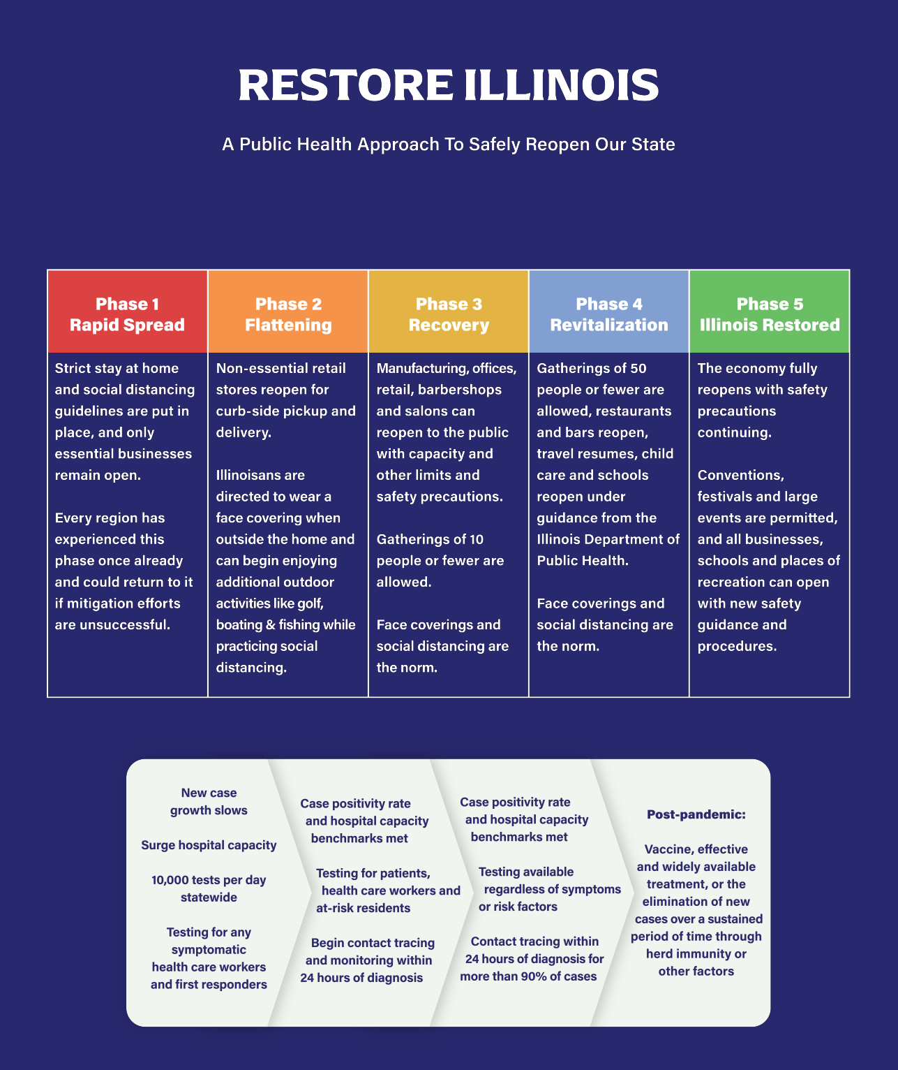
IL Department of Public Health
https://www.dph.illinois.gov/
Hotline: 800-889-3931
Dated: 5.5.2020

